Slide 1
Allies Training Program
Part I
Becki Fogerty, Paul Hengesteg and Matt Moran
Office of Equity and Inclusion
Notes:
Brian talks about the office and importance of understanding LGBT issues

Slide 2
Guidelines for Allies
Respect individual privacy
Allow individuals to direct interaction
Avoid telling individuals what to do when possible
Make referrals where appropriate
Consult with the LGBT Office if you have questions

Slide 3

Homophobia and Heterosexism

Slide 4
Heterosexism
The belief that all people are heterosexual, the assumption and/or belief that heterosexual relationships and behavior are superior, and the actions based on this assumption.

Slide 5
Homophobia
Fear, anger, discomfort, intolerance, or lack of acceptance toward LGBT people, or experiencing these feelings about one's own non-heterosexual preference.

Slide 6
Levels of Attitude about LGBT People
Repulsion
Pity
Tolerance
Acceptance
Notes:
Repulsion: Homosexuality is seen as a "crime against nature." Gays/lesbians are sick, crazy, immoral, sinful, wicked, etc. Anything is justified to change them: prison, hospitalization, behavior therapy, electroshock therapy, etc.
Pity: Heterosexual chauvinism. Heterosexuality is more mature and certainly to be preferred. Any possibility of "becoming straight" should be reinforced, and those who seem to be born "that way" should be pitied, "the poor dears."
Tolerance: Homosexuality is just a phase of adolescent development that many people go through and most people "grow out of." Thus, lesbians/gays are less mature than "straights" and should be treated with the protectiveness and indulgence one uses with a child. Lesbians/gays should not be given positions of authority because they are still working through their adolescent behavior.
Acceptance: Still implies there is something to accept. Characterized by such statements as "You"re not lesbian to me, you"re a person!" or "What you do in bed is your own business." or "That"s fine with me as long as you don"t flaunt it!”

Slide 7
Levels of Attitude about LGBT People
Repulsion
Pity
Tolerance
Acceptance
Support
Admiration
Appreciation
Nurturance
Notes:
Support: The basic ACLU position. Work to safeguard the rights of lesbians and gays. People at this
level may be uncomfortable themselves, but they are aware of the homophobic climate and the irrational unfairness.
Admiration: Acknowledges that being lesbian/gay in our society takes strength. People at this level are willing to truly examine their homophobic attitudes, values, and behaviors.
Appreciation: Value the diversity of people and see lesbians/gays as a valid part of that diversity. These people are willing to combat homophobia in themselves and others.
Nurturance: Assumes that gay/lesbian people are indispensable in our society. They view lesbians/gays with genuine affection and delight, and are willing to be allies and advocates.

Slide 8
Identifying Heterosexism
Stereotypes and assumptions are at the root of heterosexist attitudes, simplifying the diverse LGBT community and often disarming them. The following actions and thoughts are manifestations of these attitudes.

Slide 9
Identifying Heterosexism
Oversexualization
Denying Personal Significance
Assuming that lesbians, gay men, and bisexuals are only sexual beings rather than complex people who have, among other significant features, a non-heterosexual orientation
Commenting that “it doesn’t matter to me that you are LGBT” – a basic part of someone’s identity and sense of self should matter, but not negatively

Slide 10
Identifying Heterosexism
Making it Invisible
Overassertion of Heterosexuality
Assuming that everyone is heterosexual
Considering heterosexism less significant than other oppressions
Making your sexuality clear to others because of fear of being labeled as LGBT

Slide 11
Identifying Heterosexism
Expecting to be Taught
Misdefining Sexuality
Putting the burden of responsibility for educating and working for change on the LGBT individual
Making assumptions about what it means to be bisexual or homosexual

Slide 12
How Homophobia Hurts Us All
LGBT people may be hesitant to come out
They are likely affected by heterosexism
They may be unaware of how they are affected
Internalized homophobia
  Get used to expecting less, feel less deserving
Tolerance or acceptance often assumed to be the best possible reactions

Slide 13
How Homophobia Hurts Us All
You do not have to be gay, lesbian, or bisexual or know someone who is to be negatively affected by homophobia. Though homophobia actively oppresses gay men, lesbians, and bisexuals, it also hurts heterosexuals.

Slide 14
How does it hurt non-LGBT?
Homophobia…
Inhibits the ability of heterosexuals to form close, intimate relationships with members of their own sex, for fear of being perceived as lesbian, gay, or bisexual
Locks people into gender roles that may inhibit self-expression
Is often used to stigmatize heterosexuals: those perceived or labeled by others to be by LGBT and their friends and families
Inhibits appreciation of other types of diversity, making it unsafe for everyone because each person has unique traits not considered mainstream or dominant

Slide 15
Bisexual
A person who is emotionally, physically, spiritually, and sexually attracted to members of more than one gender. Also can be referred to as omnisexual and pansexual.

Slide 16
Facts about Bisexuality
Bisexuality is the potential to feel attracted to and engage in sensual and/or sexual relationships with people of any sex.
A bisexual person may not be equally attracted to both sexes and the degree of attraction may vary over time.
Bisexuality can be
  a stage in the process of acknowledging homosexuality
  an identity in and of itself
Bisexuality as an identity is often ignored or considered “part gay and part straight”

Slide 17
Facts about Bisexuality
It is a myth that bisexuals have “the best of both worlds”
They often are stigmatized by both the straight community and the gay community as not fitting into either
A bisexual person does not need to be sexually involved with a man and a woman simultaneously
The ability to create a relationship with either sex depends more upon the individual's personality than it does upon bisexuality, as well as the other person’s understanding of differing sexual orientations.
Some people who identify as bisexual never engage in sexual activity with more than one sex

Slide 18
Transgender
An umbrella term for people who transgress society's view of gender and biological sex as necessarily fixed, unmoving, and following from one's biological sex. They view gender on a spectrum, rather than a polarized, either/or construct.
Notes:
This can range from identification to cross dressing, to undergoing hormone therapy, to sex reassignment surgery and/or to other forms of dress/presentation. Transgender people can include transsexuals, cross-dressers, drag kings/queens, masculine women, feminine men, and all those who defy what society tells them is appropriate for their "gender". Political trans activists seek to create more space around gender, and to create a space and a society where the choice of gender expression/presentation is safe, sane, and consensual.

Slide 19
Transgenderism
Women
Women
Men

Slide 20
Transgenderism
Female sex Male sex
Female gender
Male gender
Women
Women
Men
Men

Slide 21
Transgenderism
Female sex Male sex
Female gender
Male gender
Women
MTF Transsexual
FTM Transsexual
Men

Slide 22
Facts about Transgenderism
A transgender person is someone whose gender expression runs contrary to what other people in the same culture would normally expect. There are several types:
  FTM (female to male): born female but see themselves as partly to fully male
  MTF (male to female): born male but see themselves as partly to fully female
  Intersexed: born with a combination of male and female physiology (similar to hermaphrodite) – may accept their mixed gender as natural while most are assigned to one sex shortly after birth

Slide 23
Facts about Transgenderism
Transvestite: person who wears clothes identified with the opposite gender for emotional or psychological satisfaction, often but not always straight
Drag Queen: female-emulating male, usually campy, often (not always) gay
Drag King: male-emulating woman
Transgenderist: person living as gender opposite to anatomical sex. Sexual orientation varies.
Transsexual: person whose sexual identity is opposite to their assignment at birth. Sexual orientation varies.
Androgyne: person appearing and identifying as neither man nor woman, presenting a gender either mixed or neutral

Slide 24
Facts about Transgenderism
Not every trans-identifying person chooses to have complete sex-reassignment surgery; some have partial surgery while others cannot or do not want any at all
Sexual Orientation, sexual identity, and gender are independent of each other. A person may express any variation of each of these in any combination.
A transgender person’s sexual orientation is unrelated to their gender identity or their sexual identity.

Slide 25
Intersexed
People born with "unexpected" genitals. Formerly referred to as hermaphrodites, intersexed people are not easily categorized as male or female because of ambiguous genitals. Most intersexed people do not possess "both" sets of genitals, rather a blending or a different appearance that is medically unacceptable to most doctors. Intersexuality is fairly common. Many who identify as intersexed believe that early childhood surgical intervention is not only unnecessary but cruel and advocate counseling and support for children and families.

Slide 26
Genderqueer
Any LGBT person whose gender presentation is an intentional mixture of gender signifiers, usually a political identity in support of transgender persons and against the binary gender system.

Slide 27
Transsexual
A person whose core gender identity is "opposite" their assigned sex. Transsexuals may live as the opposite sex, undergo hormone therapy, and/or have sex reassignment surgery to "match" their bodies with their gender identity.

Slide 28
Transvestite
A person who cross-dresses for erotic pleasure or relaxation.

Slide 29
Drag
Queen, a person who consciously performs femininity, sometimes in an exaggerated/theatrical manner, usually in a show or theatre setting; King, a person who consciously performs masculinity, sometimes in an exaggerated/theatrical manner, usually in a show or theatre setting.

Slide 30
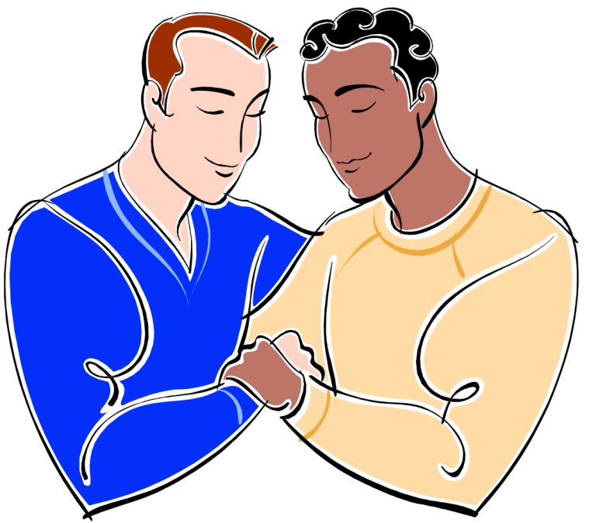
Questions/Comments?
Next Session: Here, October 27, 2-4pm

